Slide 1
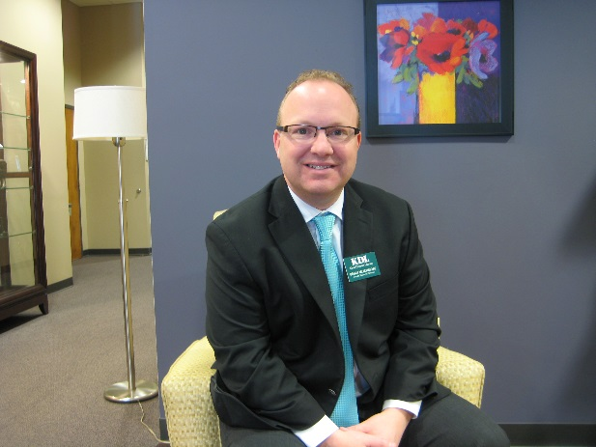
HR topics with the HR-Guy
A primer on compensation, performance management, and the exciting new employment assessment tool that’s being developed by KDL.
Brian L. Mortimore, SPHR
Kent District Library

Slide 2
Compensation
Fair Labor Standards Act of 1938
Exempt vs. Non-Exempt Status and the Department of Labor
Economics test
Staff working as Volunteers
Overtime calculation
“Comp” Time
Compensatory Time – “Donning and Doffing” / Travel / Working from phones

Slide 3
Compensation
Pay Ranges (Beginning and Ending and options for annual adjustments)
Pay Rates (Basic increases and Supplemental Adjustments)
Market Rates
Internal Equity (Equal pay for equal work)
Pay Progression and the journey to the top
“Cost of Living?”
Merit Pay (Opportunities and Challenges)

Slide 4
Compensation
Wage Compression and the challenges of too many ranges
“Slotting” new positions in an existing range
“Red Circle Rates” and some solutions to address them
“Green Circle Rates” and some solutions to address them
“Aging” salary data
Library rules for promotion, transfer, demotion, probation, reclassification.

Slide 5
Performance Management
Traditional Challenges (Recency / Halos & Horns / Central Tendancy / Honesty / Inflated).
An anxiety producing event for both parties…

Slide 6
Performance Management
The KDL “Check-In” Process is a two-step process
Check-in with the employee
Ask,
What are you working on?
Is there anything standing in your way?
What do you need from me?
Then,
Recognize them for the work they’re doing.

Slide 7
Performance Management
Example:
Q: “What are you working on, or, what’s your immediate priority?”
A: “I’m trying to get more teen volunteers to help with Summer Reading Club registration.”
Q: “Do you have enough?”
A: “Not yet. Last year I had twice as many.”
Q: “Would it help if I placed a call to some of the Friends to get the word out that we’re looking for volunteers?”
A: “Yes, that would be great.”
Q: “OK, I’ll check back after I call the Friends. I want you to know that I appreciate all your hard work with this. It may be challenging now but I know we’ll have a great Summer, in large part because of your efforts.”

Slide 8
Performance Management
The KDL “Check-In” Process is a two-step process
2. Check in with your employee performance logs
Example:
6/2/17 – Met with April and discussed concerns around SRC. Specifically, lack of teen volunteers. I contacted the Friends to put out a call for help. April has been very busy ensuring the success of the program developing promotion and securing prizes.

Slide 9
Performance Management
The initial feedback from KDL Management….

Slide 10
Employment Testing
Tim Horton’s, Time Magazine, and how we got here…

Slide 11
Employment Testing
Are you interested in becoming a part of our study?
Send an e-mail to bmortimore@kdl.org with the subject line “Bookmark”.

Slide 12
Questions
Brian will address a few questions that are typed and sent in to the moderator.
Thank you very much!
-Brian

